Slide 1
Hotel Aggregator Analysis - Power BI -
BY
TIAMIYU NURUDEEN TOBILOBA

Slide 2
CONTENT
INTRODUCTION
DATASET CLEANING
ANALYSIS OF DATA IN
POWER BI
KEY INSIGHTS
RECOMMENDATIONS
CONCLUSION

Slide 3
INTRODUCTION
The goal of this project is to analyze a dataset of hotel aggregator listings using Power BI. The dataset includes attributes related to listings, hosts, reviews, and availability. The objective is to generate comprehensive visualizations and insights that highlight trends, patterns, and factors influencing the Performance of listings. I analyze key metrics like pricing, availability, host characteristics, and review scores to gain actionable insights for improving listing quality and competition.

Slide 4
DATASET CLEANING
Connecting Microsoft Power BI to our dataset.
Checking for null, duplicate, replace irrelevant values or columns.
Starting our data analysis.

Slide 5
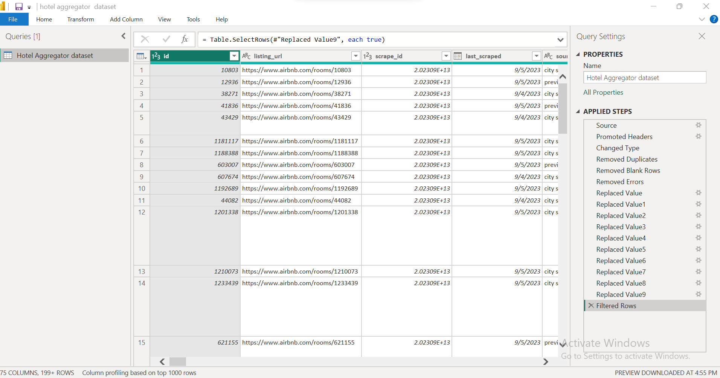
Connecting Microsoft Power BI to our dataset And Checking for null, duplicate, replace irrelevant values or columns.

Slide 6
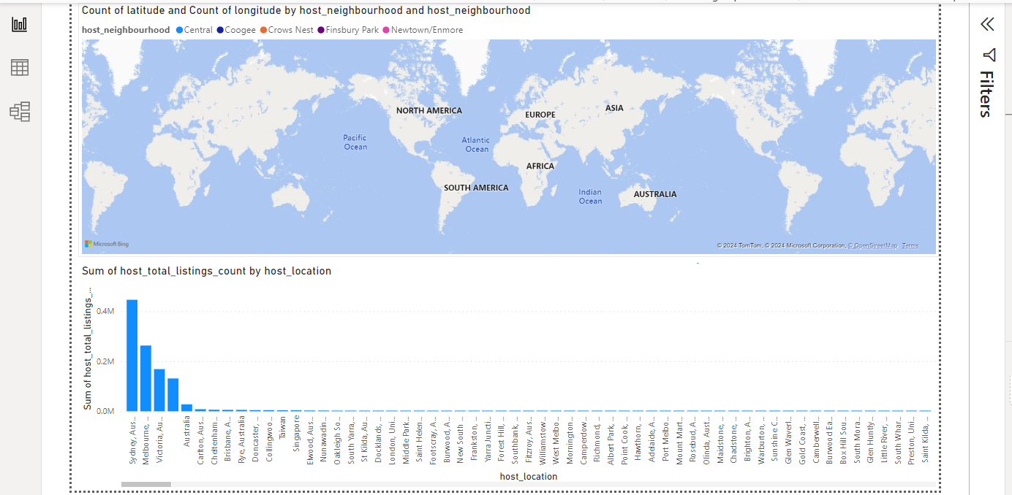
ANALYSIS OF DATASET IN POWER BI Starting our data analysis.
Sydney, Australia accounted for 39.23% of the total host listing count. The sum of host_total_listing_count varied across all 958 host_locations, from 1 to 446281. While the top 5 host Neighborhood Center, Coogee, Crowns Nest, Finsbury Park, and Newtown/Enmore
QUESTION 1

Slide 7
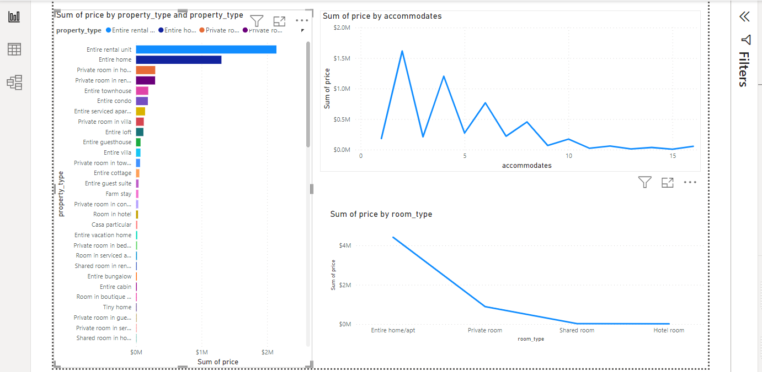
QUESTION 2
Pricing and Availability Analysis:
Analyze pricing trends based on property types, room types, and accommodation capacity.
In the pricing and availability analysis, Entire home/apt had the highest total price at $4,417,801, dominating with 82.43% of the market share, while Shared rooms had the lowest at $25. The Entire rental unit category was the most expensive among property types.

Slide 8
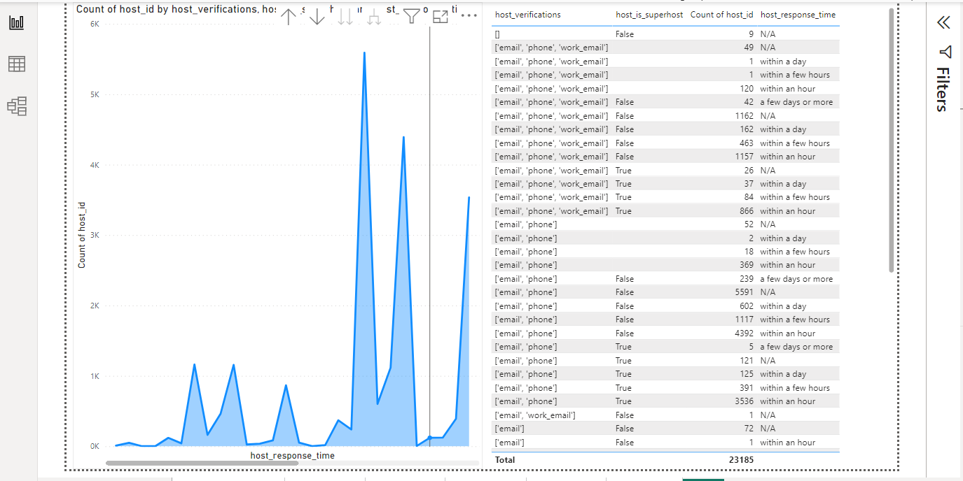
QUESTION 3
Hosts without verification had the highest total host ID sum at 2,768,643,191,548, which is 74.28% of the total, For host verifications, the combination of [‘email’, ‘phone’] led with a sum of 2,608,668,557,802, comprising 69.99% of the total across all verification types. Regarding response time, hosts with a response time of “within an hour” had the highest sum of host IDs at 2,171,776,175,850, accounting for 58.27%
Host Performance:
Evaluate host characteristics, including superhost status, response times, and verification methods.

Slide 9
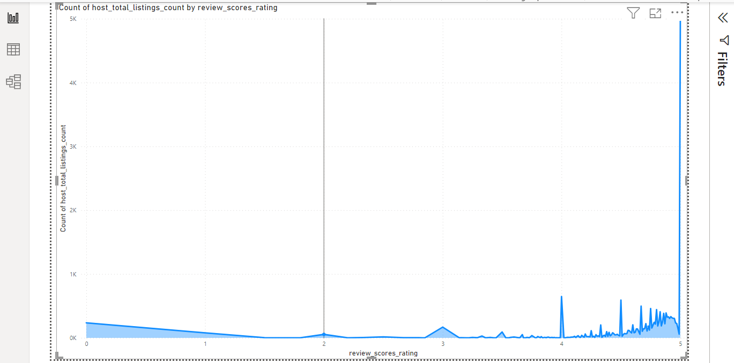
QUESTION 4
Review Scores and Guest Satisfaction:
Examine review scores and their impact on overall listing performance.
The summary of the review data is that hosts with 5 listings had the highest count at 4,983, making up 21.49% of the total listings count, with a range of 1 to 4,983 listings across 164 review scores.

Slide 10
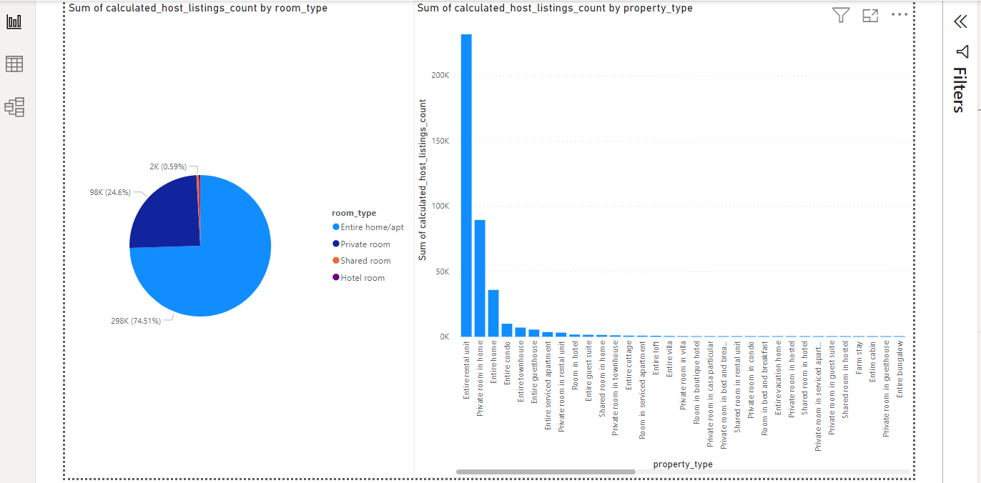
QUESTION 5
The Entire home/apt led with the highest total host listings count at 298,238, which is 74.51% of the overall listings.
Entire rental units topped the property types with 231,346 listings, making up 57.80% of the total.
The count of host listings varied widely across 83 property types, ranging from 1 to 231,346.
Property Type and Room Analysis:
- Analyse the distribution of property types and room types.

Slide 11
KEY INSIGHTS
The Host Listings and Locations
Sydney, Australia accounts for 39.23% of the total host listing count.
Host listings vary across 958 host locations, ranging from 1 to 446,281 listings.
Top 5 host neighborhoods: Neighborhood Center, Coogee, Crowns Nest, Finsbury Park, and Newtown/Enmore.
Property Types and Prices
Entire rental units have the highest total price sum at $2,141,271, accounting for 39.95% of the total price sum.
The price sum for property types ranges from $25 (Shared room) to $2,141,271 (Entire rental unit).
2-bedroom units have the highest price sum at $1,617,749, while 15-bedroom units have the lowest at $6,624.
Entire home/apt has the highest price sum at $4,417,801, followed by Private room, Shared room, and Hotel room.
Entire home/apt accounts for 82.43% of the total price sum for room types.
Host Verification and Response Time
Hosts with 'False' status have the highest sum of host_id at 2,768,643,191,548, accounting for 74.28% of the total.
'Email and phone' verification method has the highest sum of host_id at 2,608,668,557,802.
Hosts responding 'within an hour' have the highest sum of host_id at 2,171,776,175,850, accounting for 58.27% of the total.
Listing Counts
Hosts with a total listings count of 5 have the highest count at 4,983, accounting for 21.49% of the total.
Entire home/apt has the highest sum of calculated host listings count at 298,238, accounting for 74.51% of the total.
Entire rental units have the highest calculated host listings count at 231,346, accounting for 57.80%.

Slide 12
RECOMMENDATIONS
The Target Popular Locations
Focus marketing efforts and resources on Sydney and the top-performing neighborhoods (Neighborhood Center, Coogee, Crowns Nest, Finsbury Park, and Newtown/Enmore) to maximize occupancy and revenue.
Optimize Property Types
Given that entire rental units and entire home/apts generate the highest revenue, prioritize listing these types of properties.
Encourage hosts to consider offering entire homes/apartments due to their higher share of total price sum.
Enhance Verification and Response Time
Improve host verification processes to ensure more listings fall under reliable verification categories like 'email and phone'.
Encourage hosts to respond within an hour to increase their attractiveness to potential guests, as this category shows the highest sum of host_id.
Maximize Host Listings
Encourage hosts with fewer listings to increase their count, especially targeting those with a listing count of 5 or more, as this category has the highest count.

Slide 13
CONCLUSION
The data show significant trends and opportunities in the short-term hotel aggregator market. Sydney and specific neighborhoods within it are key areas of focus, with entire rental units and homes/apartments showing the greatest revenue potential. Efficient verification methods and rapid response times are critical to host success. Hosts and platforms can increase revenue and market presence by focusing on these key areas and optimizing property offerings

